Slide 1
CS211 Computer Architecture Fall 2019
Section 10
Recitation 1

Slide 2
About Me
Priya Parikh
Email: priya.parikh@rutgers.edu or pp649@scarletmail.rutgers.edu
Office Hours: Wednesday and Thursday 2 PM – 3 PM
Hill 264A?

Slide 3
Introduction
Intro to C Programming
Computer Arithmetic (binary)
Assembly x86
Digital logic and design
Caches

Slide 4
Today
iLab machines
Setting up SSH clients
PuTTy, X2go
Mac terminal
How to sign into an iLab machine
Using text editor (vim, vi) to run C program
Things you should know about C
Practice
Setup/Q&A

Slide 5
iLab Machines
https://resources.cs.rutgers.edu/docs/instructional-lab/
Instructional Lab
Remote access to machines that support Linux
Need CS Account https://services.cs.rutgers.edu/accounts/ → Activate an account on a Computer Science system
Hill Center
Status
https://report.cs.rutgers.edu/nagiosnotes/iLab-machines.html

Slide 6
SSH – Access to iLab Machines
Mac
Mac has command line SSH client already
Applications → Utilities → Terminal
iLab Connection:
ssh netid@ip_address
ssh pp649@assembly.cs.rutgers.edu
Put in CS password
Windows
Download PuTTY: https://www.chiark.greenend.org.uk/~sgtatham/putty/latest.html

Slide 7
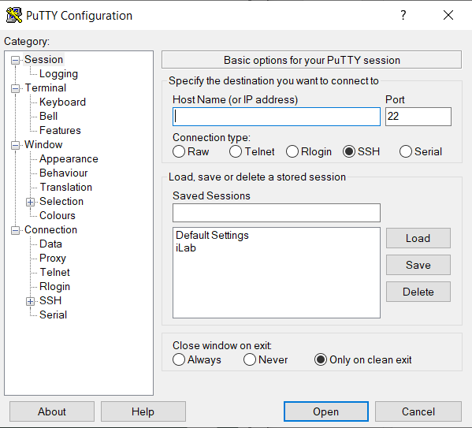
PuTTY
Host Name
iLab name
_(name).cs.rutgers.edu
Saved Sessions
Whatever you want to name the session so you can just click and go next time
Name it “iLab” and click Save

Slide 8
X2go
GUI
https://resources.cs.rutgers.edu/docs/other/x2go/

Slide 9
C – A Little Info
Structure oriented language (not OOP)
No classes with objects or inheritance, just functions
Can allocate memory manually
Types:
int, float, char
Structs
User defined
Analogous to a Node “class”
No Boolean (needs to be defined)
No string type
In C, a string is defined by a char array
Pointers
“points” to memory address where the data is stored
Will learn more about this soon
struct Node {
int data;
Node* next;
};

Slide 10
Example C Program
In terminal,
Vim is a text editor, like Notepad/Notepad++
Can look into using Atom
Command is
Always have the following library in the first line: #include <stdlib.h>
Other ones to know/have:
#include <stdio.h>
#include <math.h>
#include <string.h>
Make sure you add .c otherwise won’t be able to compile as C program
To open the file again, just use the same command
To compile use gcc
not the same as running
To run, command is
./a.out – runs what was most recently compiled
These are header files; similar Java’s imported libraries

Slide 11
Demo/Q&A
Take this time to setup your SSH client and practice running a C program!

